Slide 1
FLOWER CLASSIFICATION Using CNN
ECE 228- Machine Learn for Phys Applic
Group 5: Junfeng Zhao
Linyan Zheng
Yening Dong

Slide 2
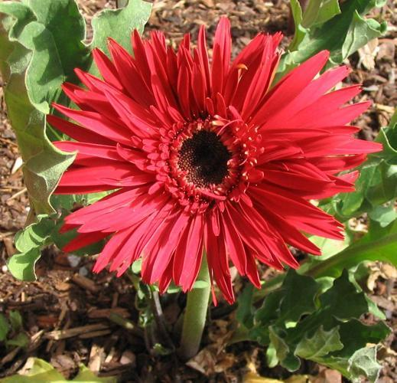
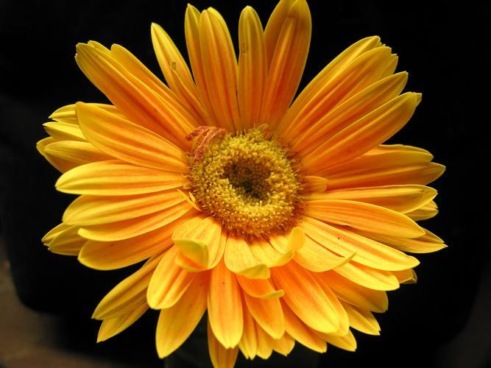
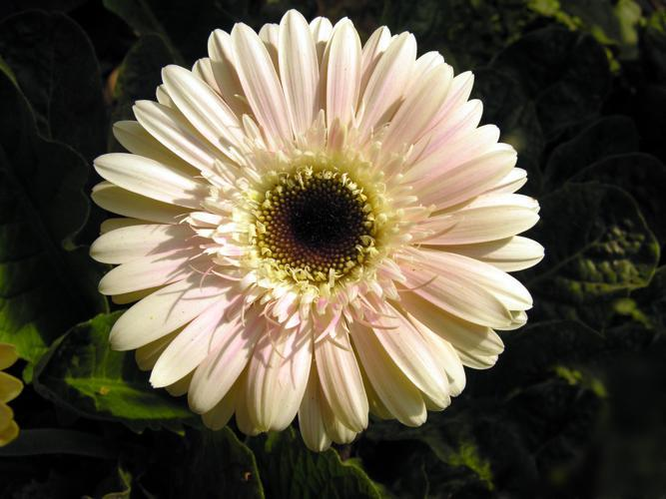
Content
Background
Literature
Dataset
Experiments
Result
Reference

Slide 3
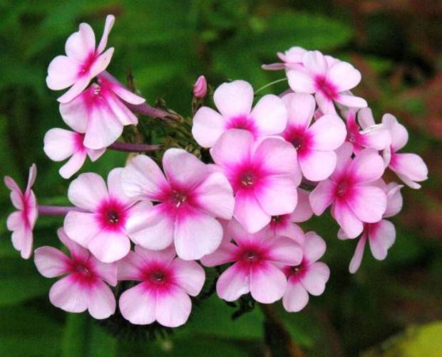
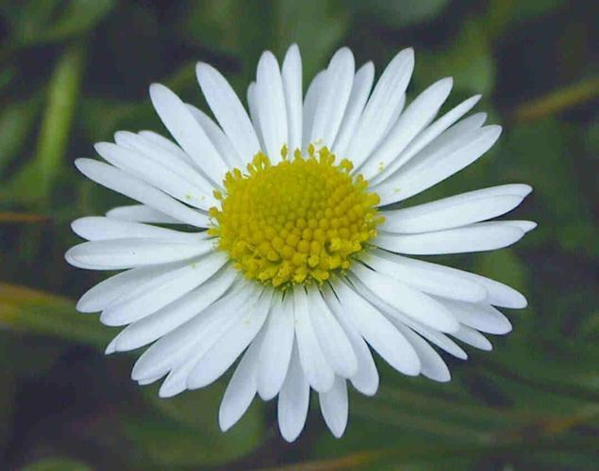
Background
In the study, we evaluated our Flower classification system using Oxford-102 Flowers Dataset.

Slide 4
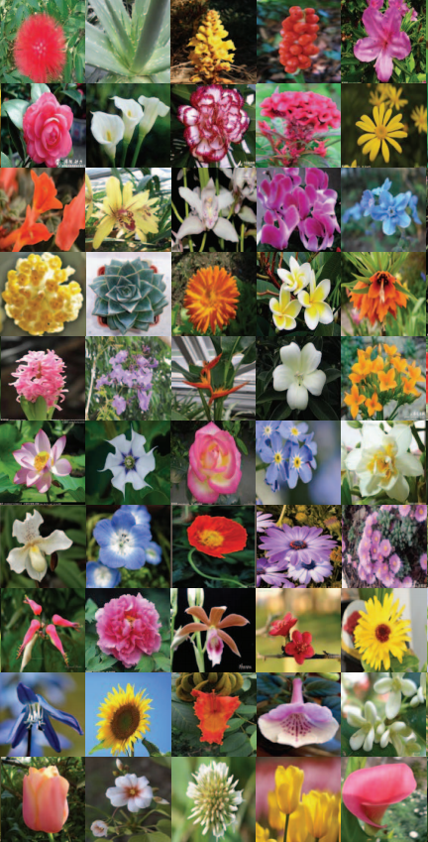
Background: WHY FLOWER CLASSIFICATION
369,000 named species of flowering plants in the world
Only experienced botanical experts recognize flowers
Instead of consulting with specialists, we can identify flowers by classifying flower images.

Slide 5
Literature Survey
The research on flower classification system is an important topic in the botanical field. Since the eighteenth century, a level hierarchical plant classification system is proposed by Carl Linneaus, and so far it has been widely used all over the world. Initially, the classification method only identifies 8,000 kinds of plant, but now we can recognize 369,000 species.

Slide 6
Literature Survey
In recent years, the flower classification improved rapidly, we can find a couple of works carried out in flower classification.
1. Nilsback and Zisserman classified flowers based on visual vocabulary with multiple SVM, using feature combination. Finally, we reached 72.8% accuracy.
2. Guru used KNN to design an automatic model for flowers classification problem.
3. Qi, Liu, and Zhao putted SIFT descriptors and context methods into coding local and spatial information, then used LibLinear SVM classifier for classification.
4. Kanan used a combined model with sparse coding, whose filters applied unsupervised learning on natural images patches.
5. Xie proposed to unify image classification and retrieval algorithms into ONE.
6. Yoo introduced a multi-scale pyramid pooling for improving performance of CNN.

Slide 7
Deep learning VS. Traditional Approach
Traditional approach: extracting the features (like edges, colors etc.) from the pictures by human method. Therefore, the accuracy depend directly on the experience.
Deep learning: no need to do feature engineering. The neural network do it for you. In this way, We can use neural network achieve a very high accuracy without having any knowledge of flowers.

Slide 8
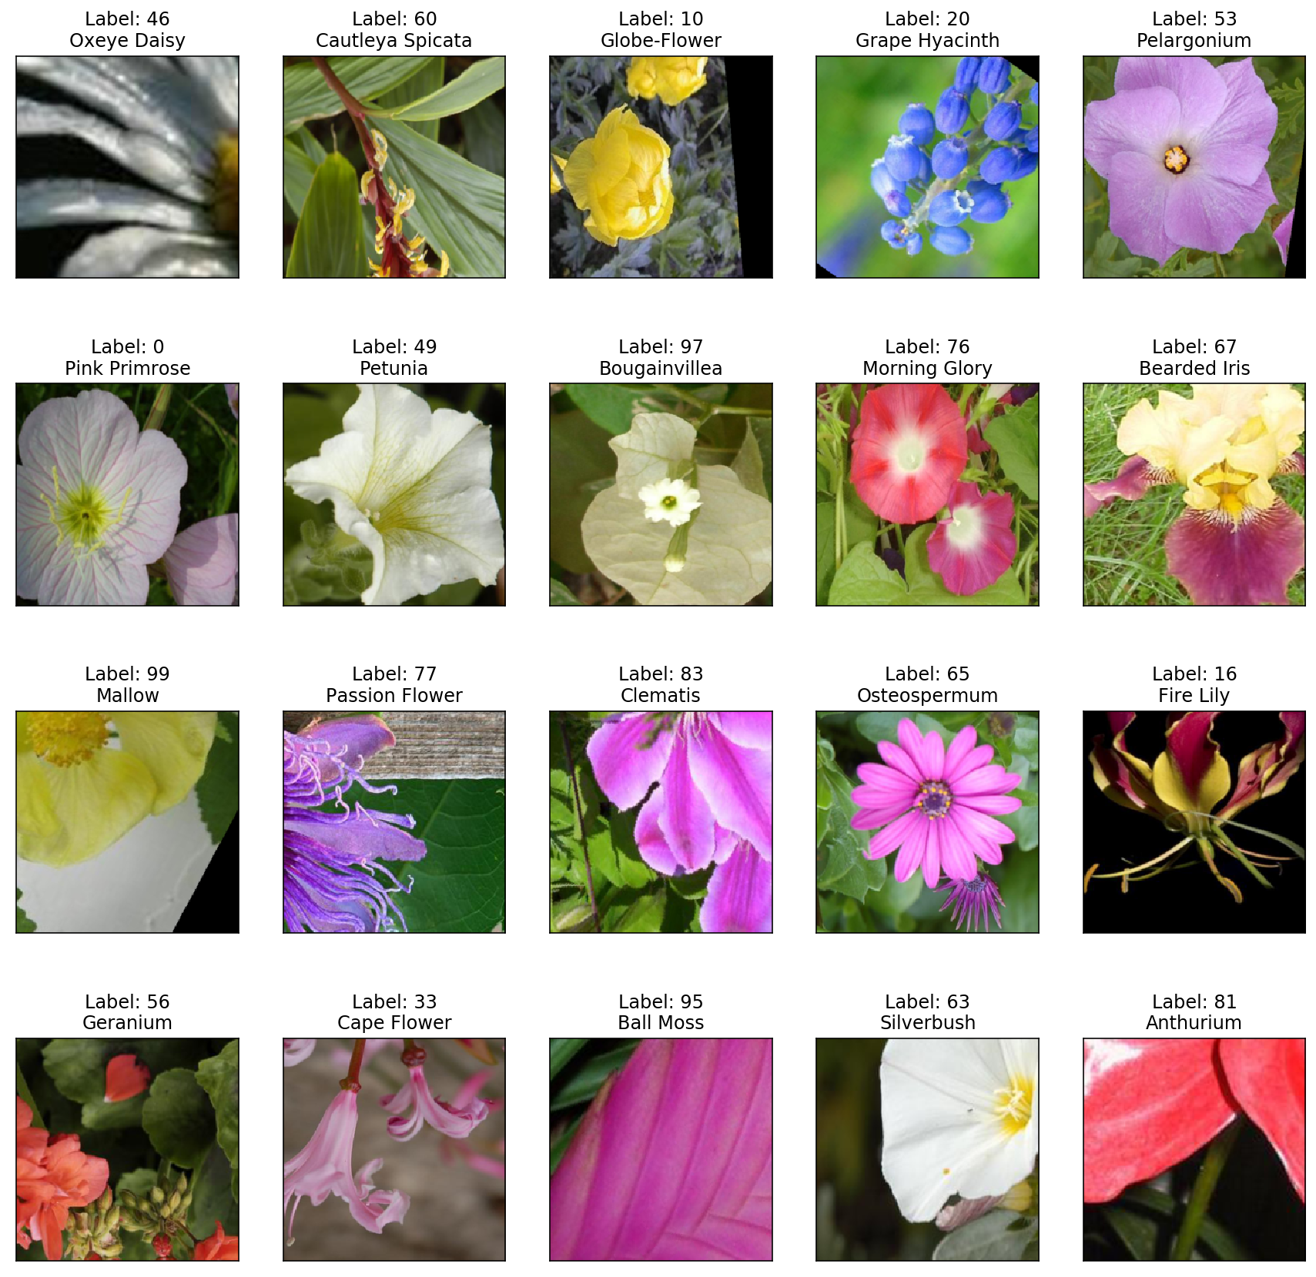
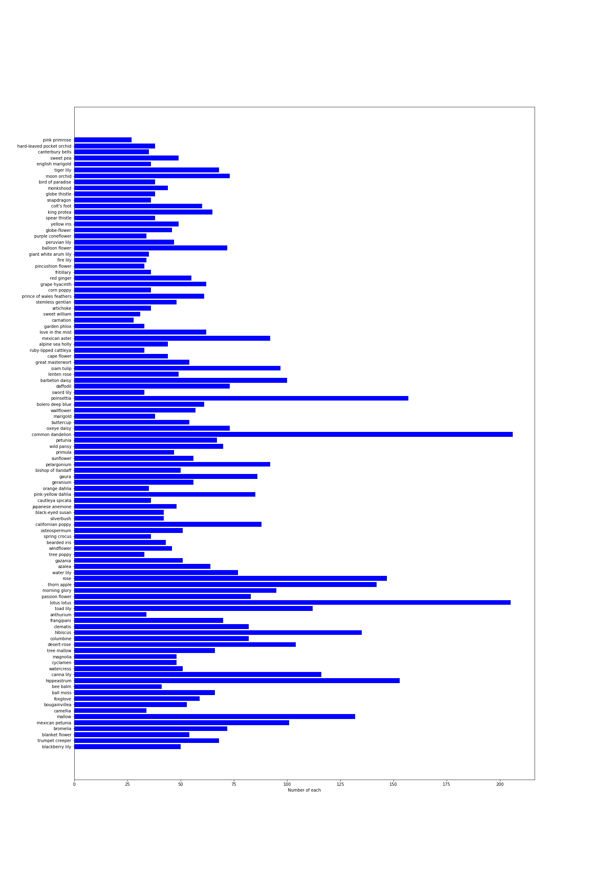
Dataset
Oxford 102 Flower Dataset
102 Classes, each: 40 ~ 258 images (nearly 500X500)
Training set: 6552 images
Valid set: 818 images
Test set: Valid set after random transformation

Slide 9
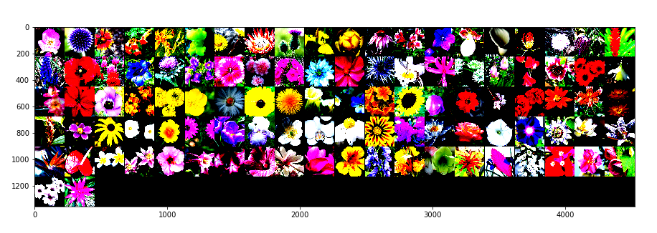
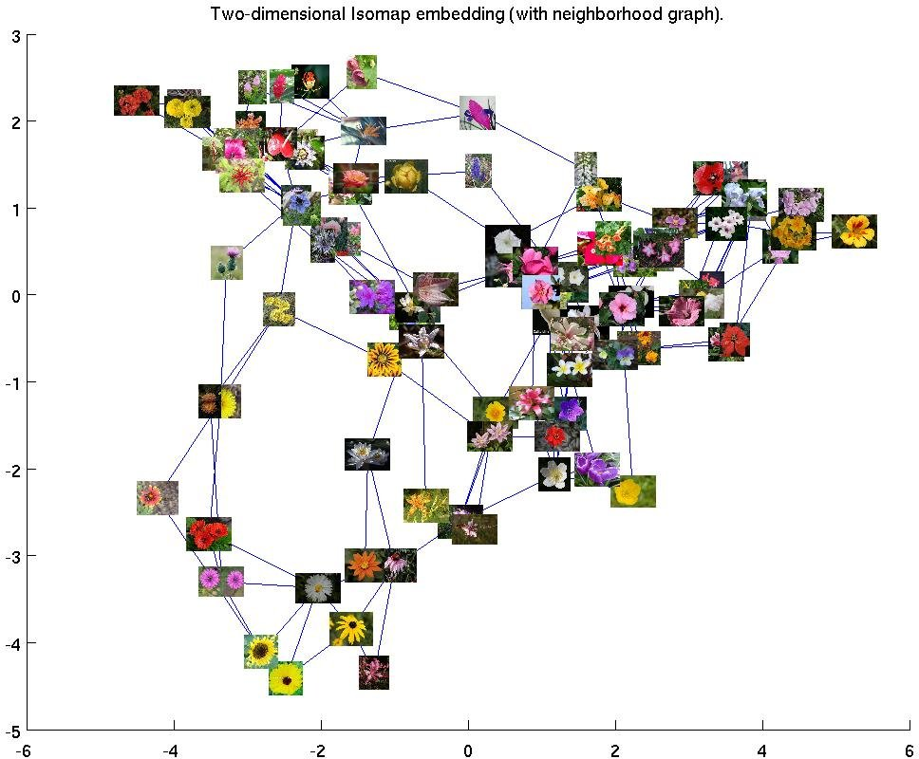
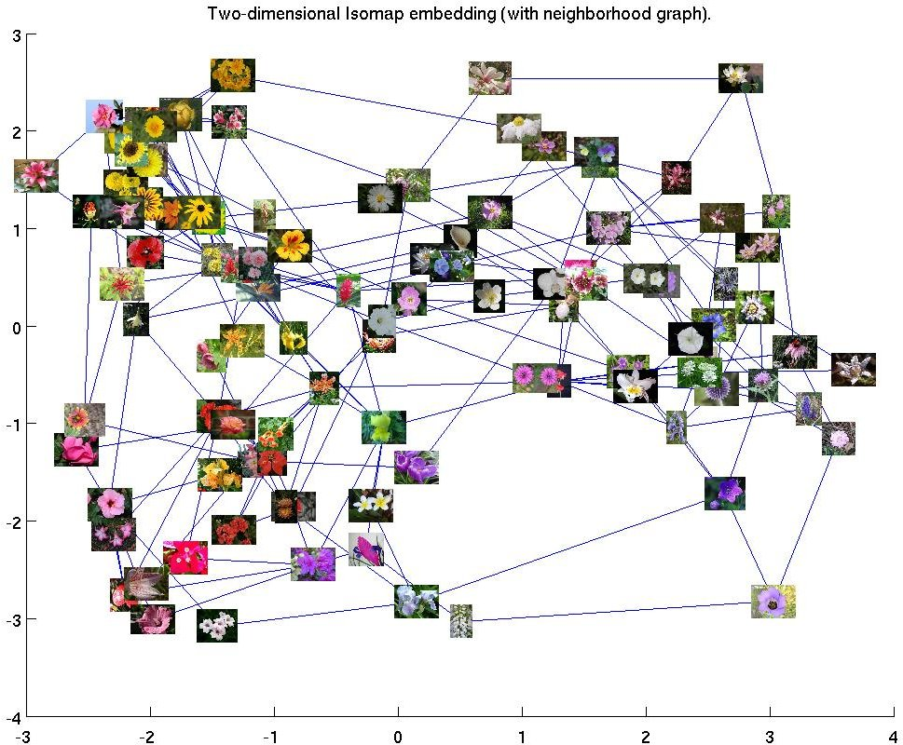
Dataset
Preprocess
resize to 224 x 224
normalize for pytorch
mean = [0.485, 0.456, 0.406]
std = [0.229, 0.224, 0.225]
group by shape
group by color

Slide 10
Feature Extraction and model:HOG+SVM(ML method)
Using HOG(Histogram of Oriented Gradients) to do feature extraction
We use hog(gray, orientations=12, block_norm='L1', pixels_per_cell=[8, 8], cells_per_block=[4, 4], visualize=False, transform_sqrt=True) function in scikit-image library(image processing library in Python).
So as the parameters show, HOG function turn our 128*128 cropped images into gray images. Then we use the L1 norm to implement Gradients calculating. Each block has 16 cells and each cell has 64 pixels. Finally hog function will return a feature vector.
Using SVM to train our model for classifying pictures
We use LinearSVC() to train our model which helps us automatically fit the features and the labels.

Slide 11
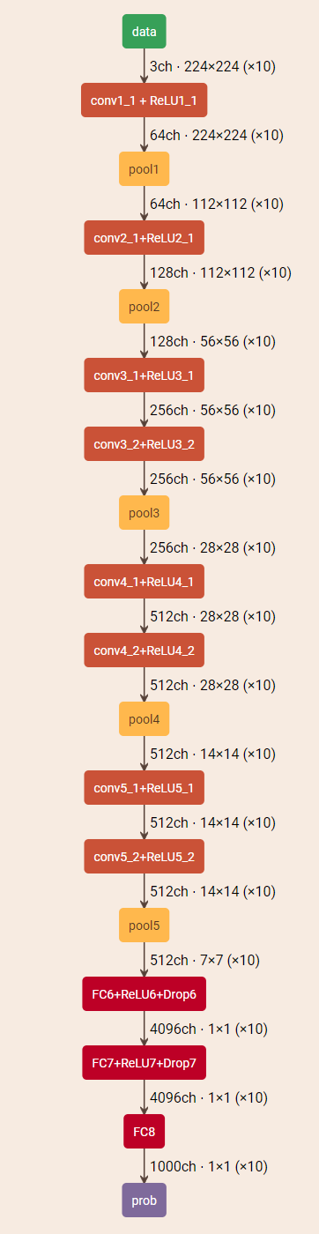
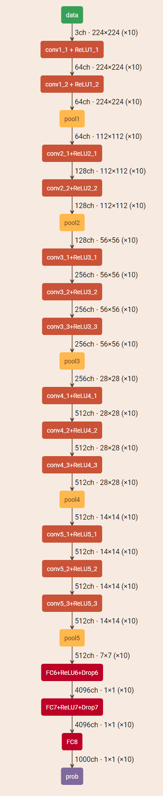
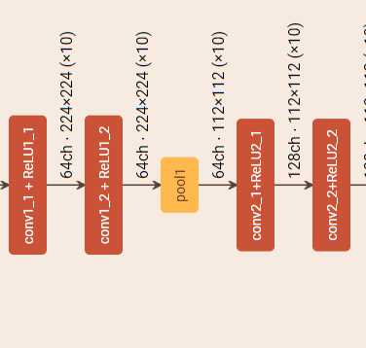
Model Details
Visual Geometry Group (VGG)
VGG11
VGG13
VGG16

Slide 12
Model Details
VGGs
We adopted VGG-16 to classify flowers. It can achieve very high accuracies.
Learning rates
We adopted lr = 0.001 in our model.

Slide 13
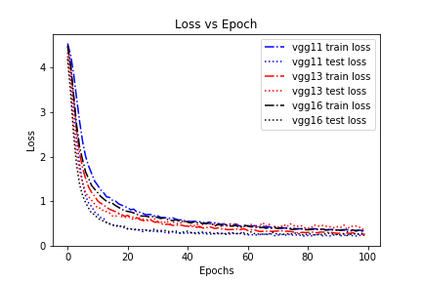
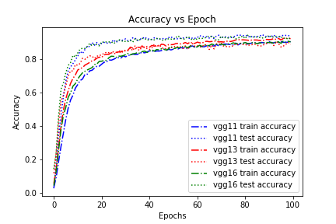
Results/Observations
VGG
VGGs are able to classify flowers at high accuracies.
Although the deeper the network is, the better performance it achieves, we don’t really need such deep networks in this case.
Notes:
Now, I’ll show you the results of our experiment for each CNN architecture.

Slide 14
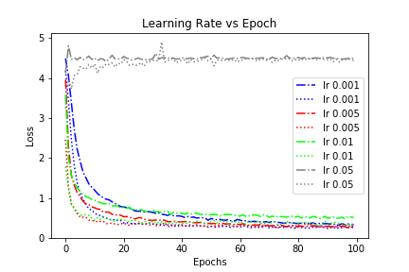
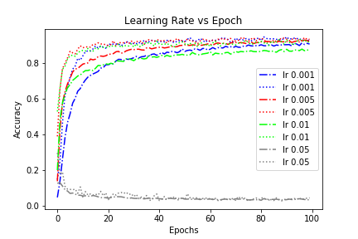
Results/Observations
Learning rates
Results are crazy when we set lr = 0.05.
lr = 0.001 might be too small for our training.

Slide 15
Summary
Method | learning rate | accuracy
VGG 11 | lr = 0.001 | 93.9%
VGG 13 | lr = 0.001 | 94.3%
VGG 16 | lr = 0.001 | 94.4%
 | lr = 0.005 | 92.8%
 | lr = 0.01 | 91.8%
 | lr = 0.05 | 11.2%
SVM |  | 19.2%

Slide 16
Prospect
Details to be improved
Q: Assume the flower part is in the center of images
Flowers show up in different parts
A: Better to segment flower parts first and then classify
we
Q: For deep neural networks, our models are relatively simple.
A:Maybe we can add a CNN network after vgg feature extraction to implement
classifying.

Slide 17
References
[1] M. Nilsback and A. Zisserman, ”A Visual Vocabulary for Flower Classification,” 2006 IEEE Computer Society Conference on Computer Vision and Pattern Recognition (CVPR 06), New York, NY, USA, 2006, pp. 1447-1454.
[2] M. Nilsback and A. Zisserman, ”Automated Flower Classification over a Large Number of Classes,” 2008 Sixth Indian Conference on Computer Vision, Graphics Image Processing,
Bhubaneswar, 2008, pp. 722-729.
[3] D.S.Guru, Y.H.Sharath, and S. Manjunath. “ Texture features and KNN in classification of flower images”, IJCA Special Issue on Recent Trends in Image Processing and Pattern Recognition (PTTIPPR), Vol. 1, pp. 2129, 2010.
[4] Wenjing Qi, Xue Liu, and Jing zhao. Flower classification based on local and spatial visual cues. In CSAE, pages 670-674, 2012.
[5] C. Kanan, G. Cottrell. Robust classification of objects, faces, and flowers using natural image statistics. In Computer Vision and Pattern Recognition (CVPR), 2010 IEEE Conference on, pages 2472-2479, 2010.

Slide 18
THANK YOU
Group 5: Junfeng Zhao
Linyan Zheng
Yening Dong

